Slide 1
stenen, euro’s en elektronen de bouwindustrie als concurrent van het energiebedrijf
Jan Willem van de Groep
@greenspirator

Slide 2

€ 13 miljard
Notes:
Is there anybody who knows what I mean with this thirteen billion Euro's? It represents the total energy bill of all households in the Netherlands. We could use these current national household expenditure that is being spent on heating, gas, and electricity to invest in the renewal of existing properties to make them completely energy self-sufficient. This money is automatically debited from the household accounts and people have no idea that it can be used and re-directed into the costs of re-building a property to make it more healthy and comfortable to live in.
When I have the possibility to spent 13 billion per year to pay interest and repayments, the bank could lend me 240 billion euro, enough for à big transition

Slide 3
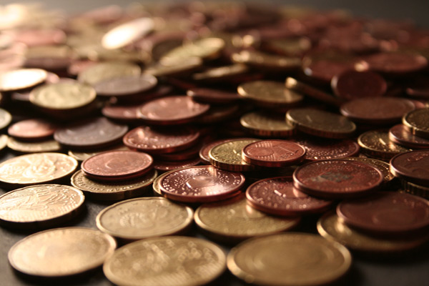
Notes:
Imagine a world where we could use and re-allocated this thirteen billion. This cash flow could be kept .. (if we create the right conditions) .. within the housing sector. In this imaginary world, this could mean that the building industry would then become one of the greatest competitors of the traditional energy companies. They can deliver the most highest form of sustainable energy...saved energy.

Slide 4
ENERGIE GEBRUIK – GEMIDDELD HUIS NL
300
Electriciteit (tv, licht, apparatuur etc.)
250
Electriciteit ventilatie
Warm water
200
Verwarmen
150
100
kW/m² / year
50
0
GEMIDDELD BESTAAND HUIS
NIEUW HUIS
BOUWBESLUIT
PASSIEF HUIS
NUL-ENERGIE
HUIS
ENERGIE PLUS
HUIS
Bron: PHI
Notes:
When we talk about sustainability in the Netherlands it's mostly about electricity...about windmills and solar power. In this graph you would see that's not the issue in case of Holland. We warm 99% of our houses with gas. So the biggest issue is about heating. The greatest sustainable impact is to decrease the energy demand, even if you're heating comes from electricity which is even more expensive than gas.

Slide 5
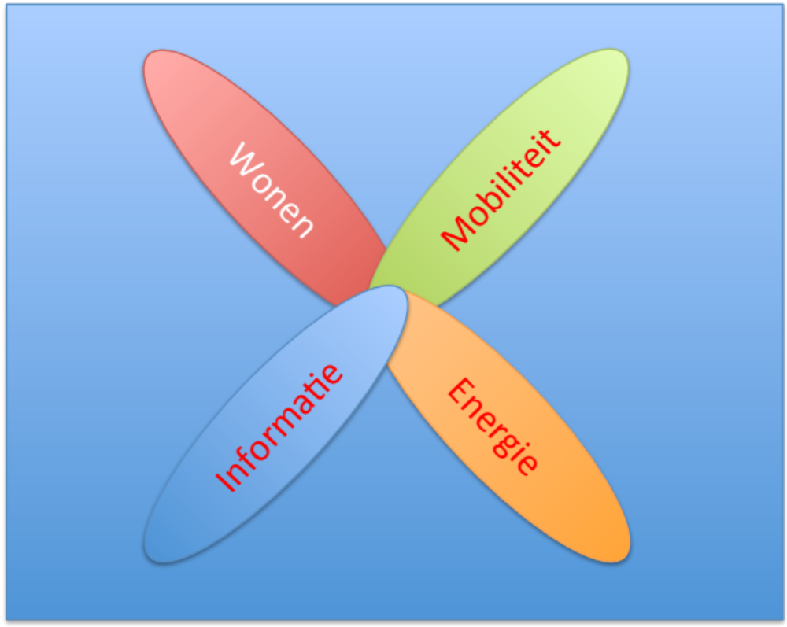
Wonen
Mobiliteit
Informatie
Energie

Slide 6
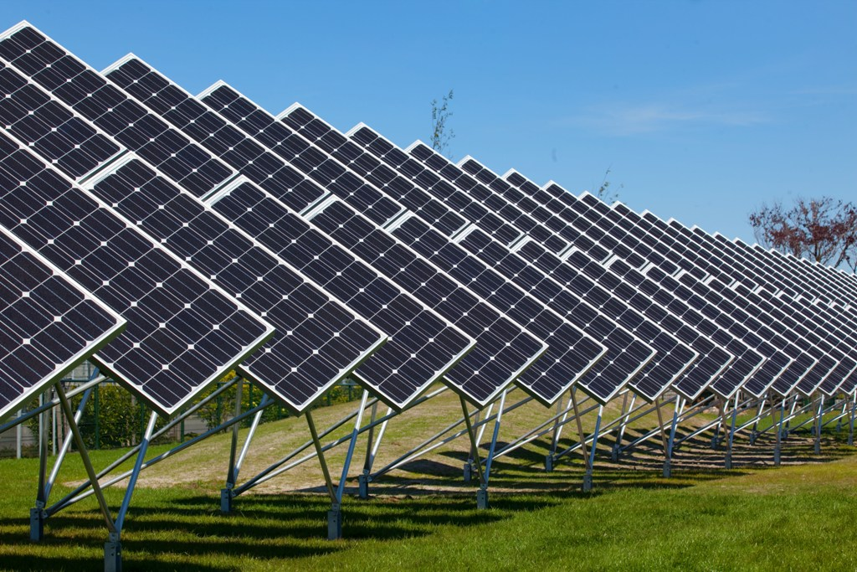
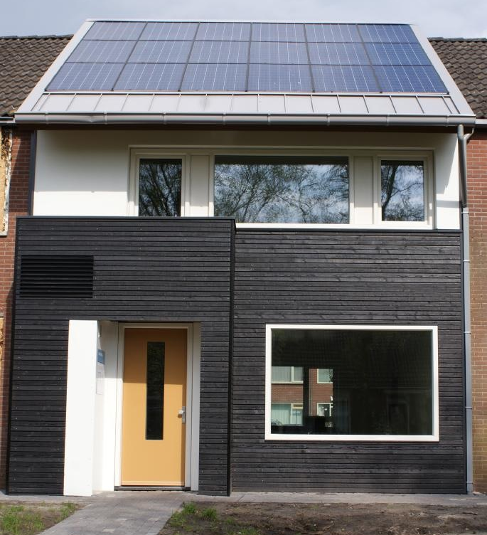

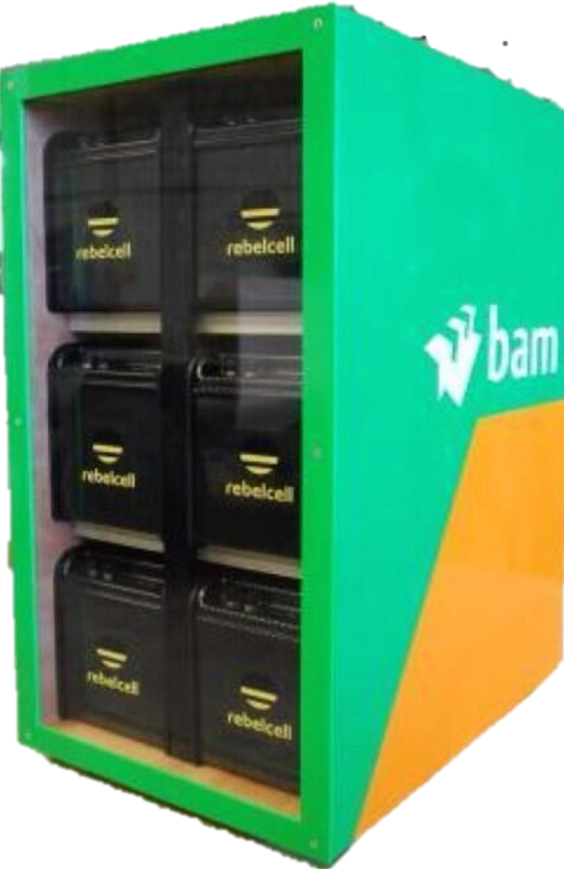
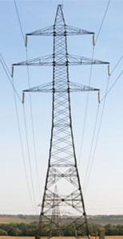
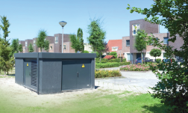
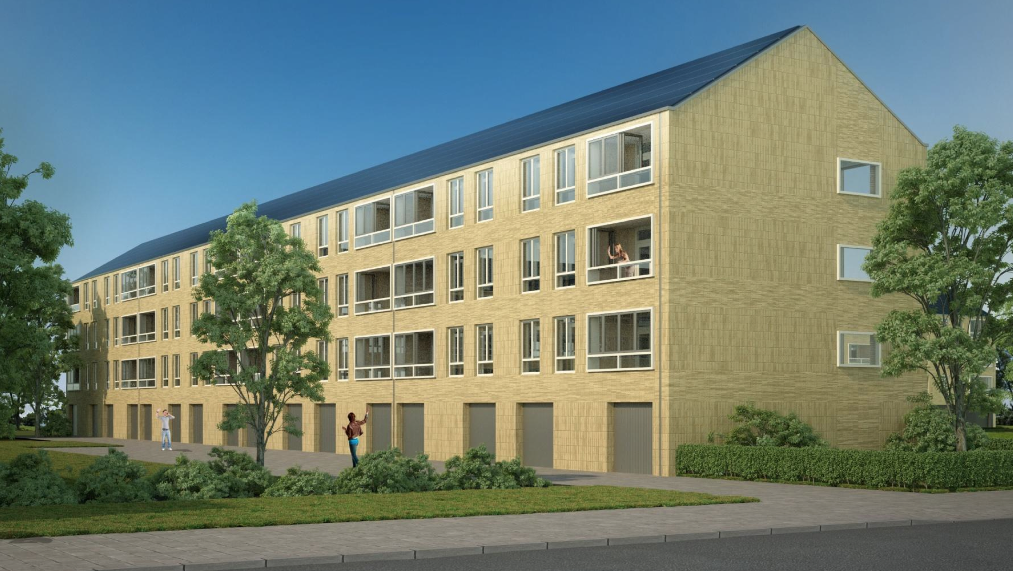

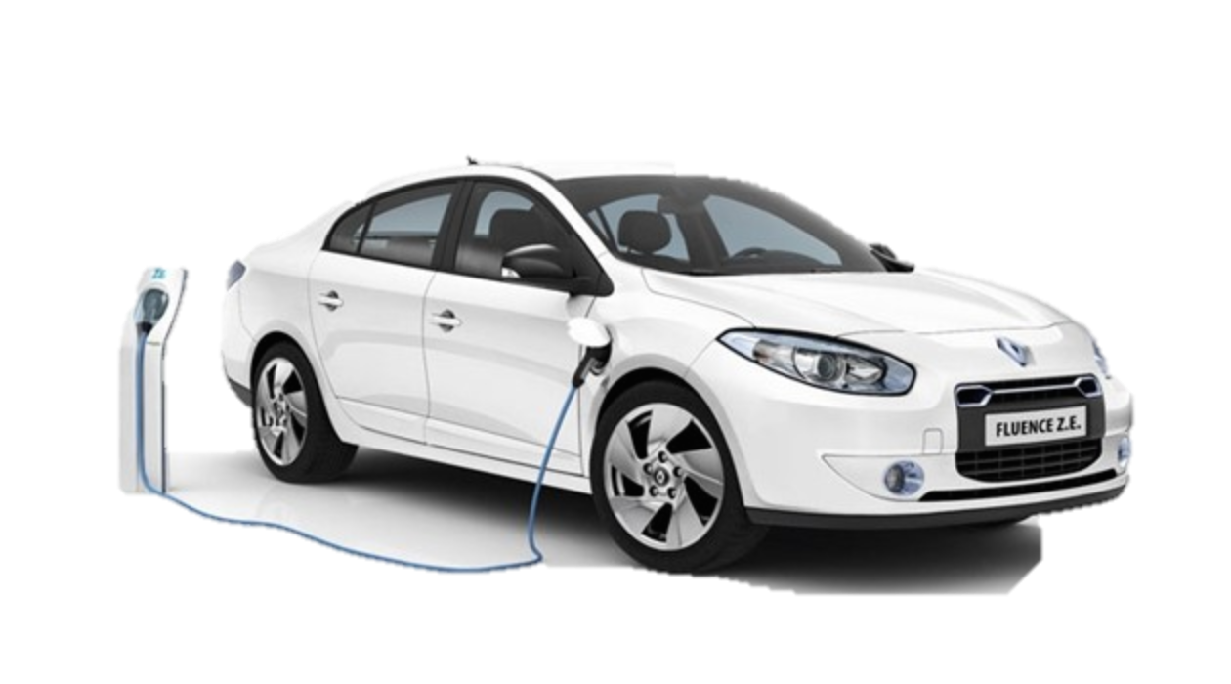
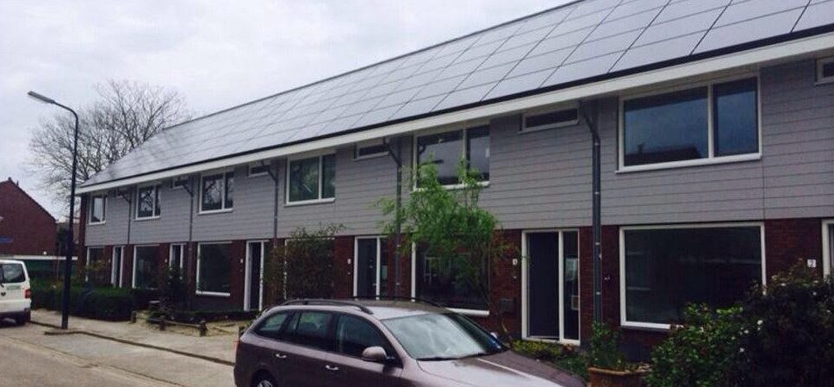
MICRO-GRID Building Environment
24 uur opslag
+30%
buurtbatterij
AC-netwerk
DC-netwerk
+30%
Vehicle-to-Grid

Slide 7
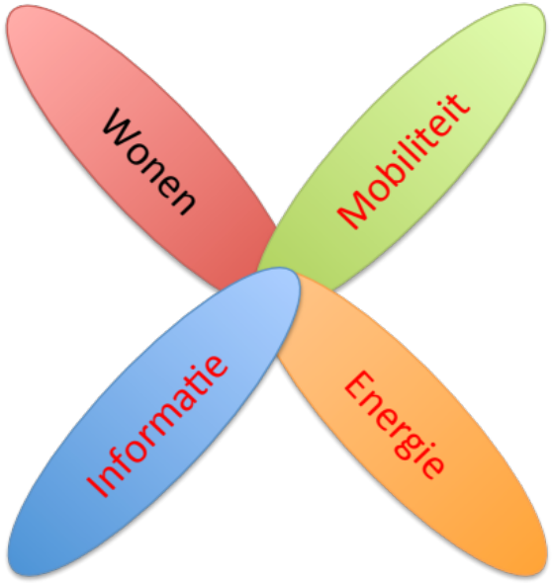
HET NIEUW ENERGIELANDSCHAP
MINIMALE WARMTEVRAAG
ALL ELECTRIC – DC
BUURTOPSLAG
GRID ONAFHANKELIJK
SLIM
SLUITENDE BUSINESSCASE

Slide 8
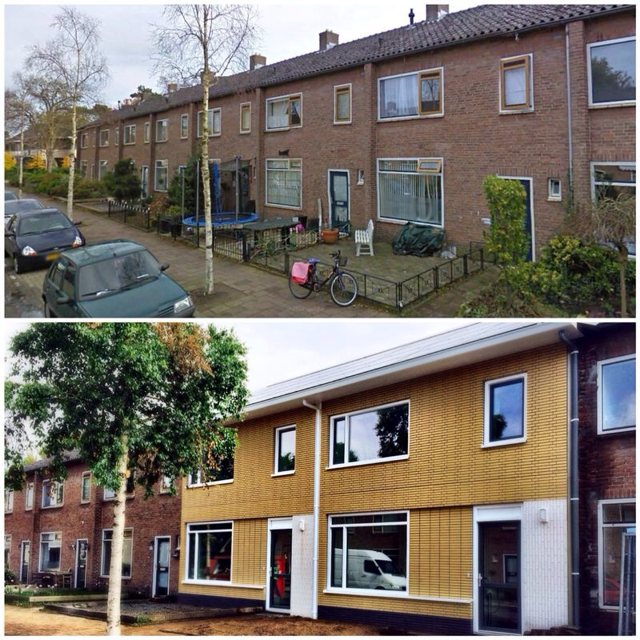
PROTOTYPE
STROOMVERNSELLING
BAM
SOESTERBERG

Slide 9
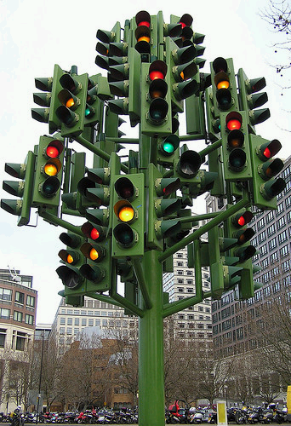
Notes:
But one green light is not a transition. We have carried out experiments during the past four years to discover which conditions would be necessary to create a big movement. How can we turn all the lights to green at the same time?

Slide 10
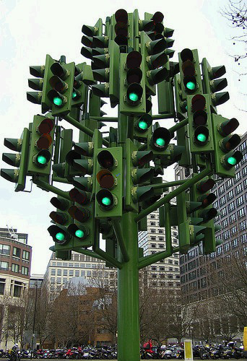
Notes:
That's the question we answered using the experiments we did with the front runners in the housing industry.
When I started with the program, I went around to find out which motivators were working within the context of the parties I interacted with. For example the increasing problems with energy poverty for low income families.

Slide 11
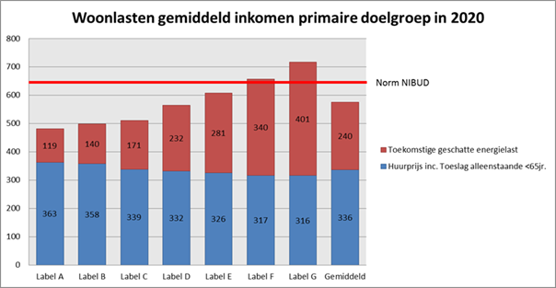
Gemiddelde woonkosten huishouden laag inkomen
energy-poverty grens
HUUR
ENERGIE
<- hoog energieperformance laag ->
Bron: PHI
Notes:
This graph, highlights that older homes with poorly build quality, have the highest energy bill and the lowest rent. With the fast growing energy costs in the West, this will soon become a problem.

Slide 12
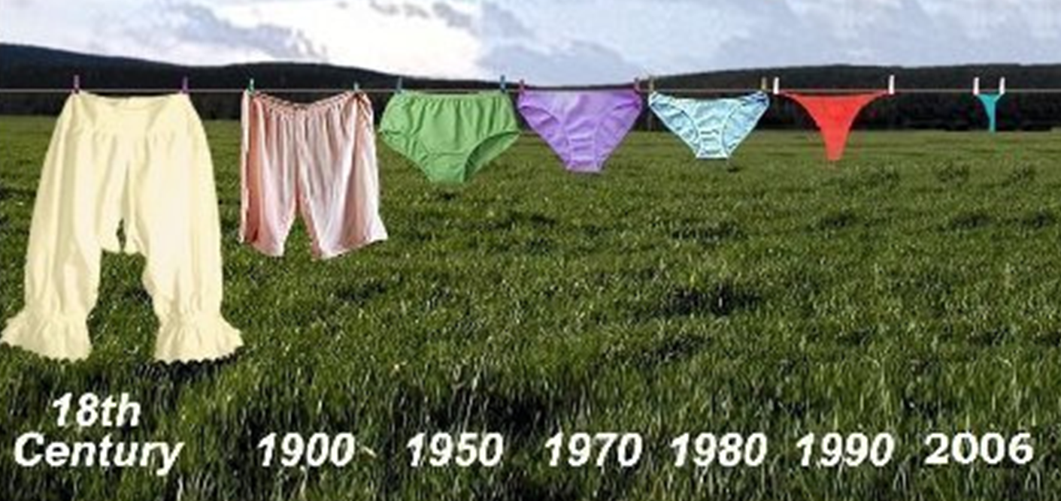
KLIMAATVERANDERING
Notes:
At the same time we have to deal with other issues which have a great impact on the building environment <slide>

Slide 13
VERGRIJZING
Notes:
such as ageing population, in-house healthcare provision and decreasing population. These arguments were falling on deaf ears. Something had to happen.

Slide 14

Notes:
Fianciele crisis, economische crisis, eurpose crisis, ecologische crisis - Blok

Slide 15
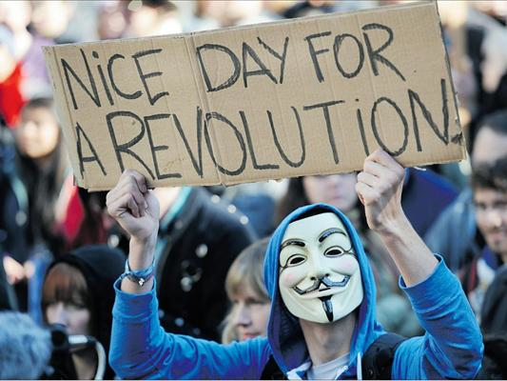
Notes:
The big catalyst came with this thought

Slide 16
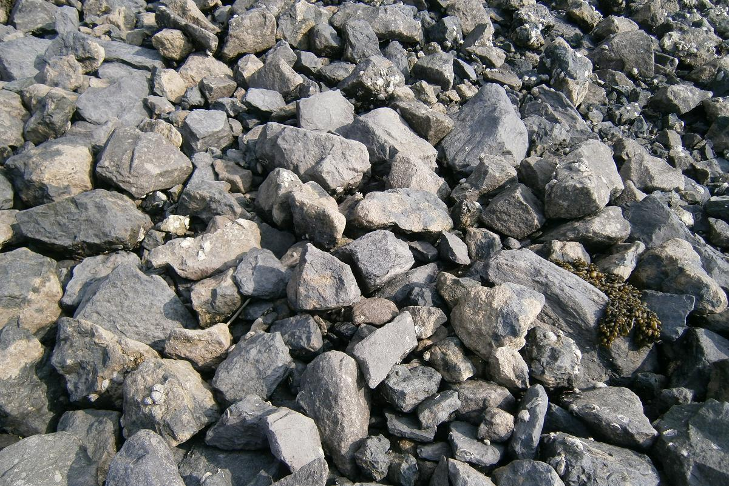
Notes:
The most valuable and sustainable energy is saved energy, so I said before. And there is no reason to deplete our fossil sources...the stone age did not end because the stones were gone!!
Oke, now I'm going to tell you something about the building industry It is about a mind shift.

Slide 17
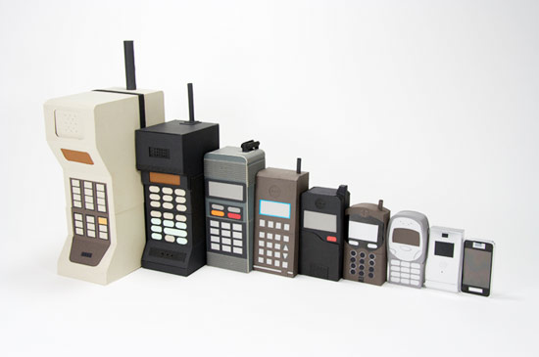
It’s about innovation
Notes:
A lot of times I used the words, should, could and would, because what I told you is not a common practice. The building industry, at the moment, is unable to supply houses as a total working system and a guaranteed product. Why is that? Because in every other industry, innovation is a survival strategy...no innovation means an exit within 5 years. Products will become smarter, cheaper, better, lighter. In the building industry: more expensive, heavier, poorer quality and ugly. <sheet>

Slide 18
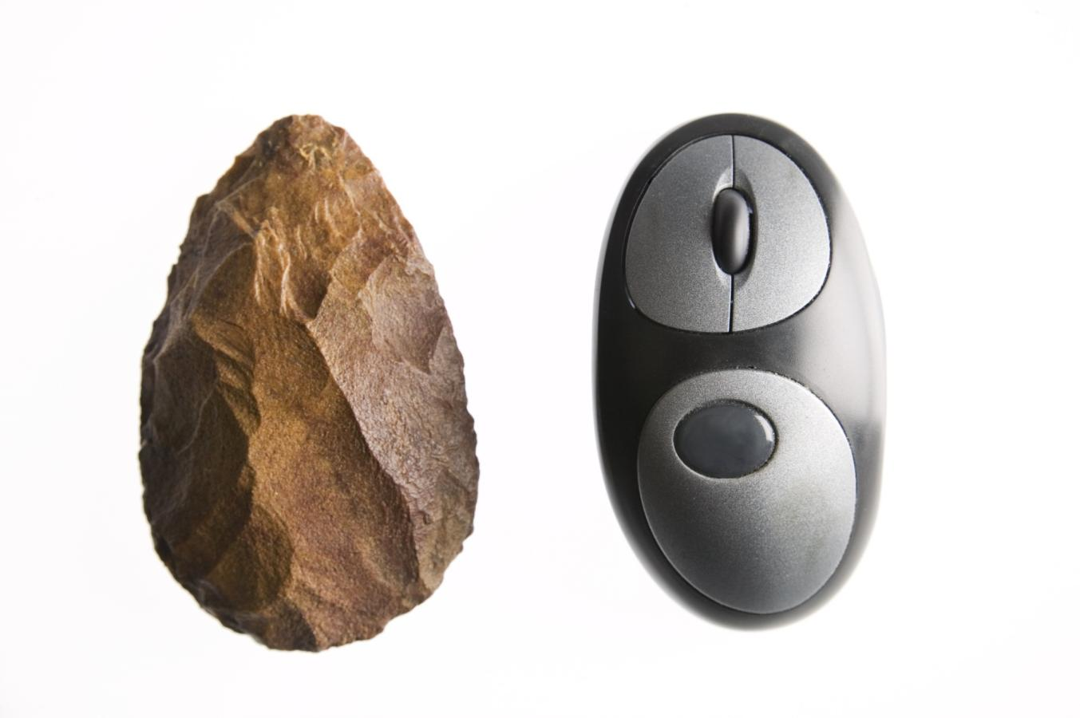
Notes:
Look at these two pieces of equipment. The left one was used by our forefathers for 30.000 generations. The right one was invented 30 years ago. It represents a complex system. And there is nobody in the world who can make a mouse alone. Why can't the building industry work together to make the complex product that a zero energy house should be. Sometimes I think the industry hasn't transcended the era of our forefathers.

Slide 19
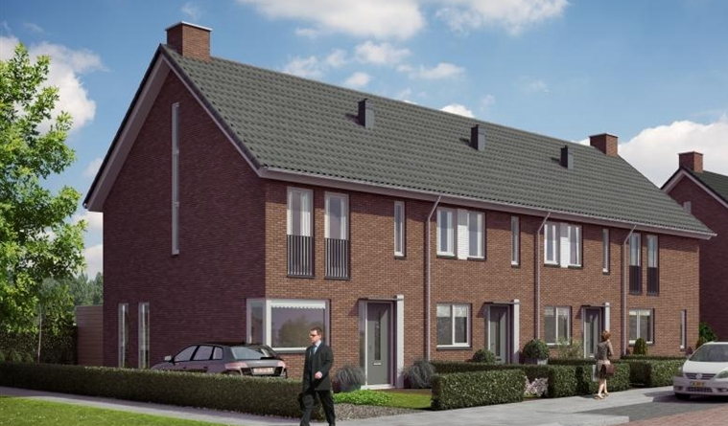
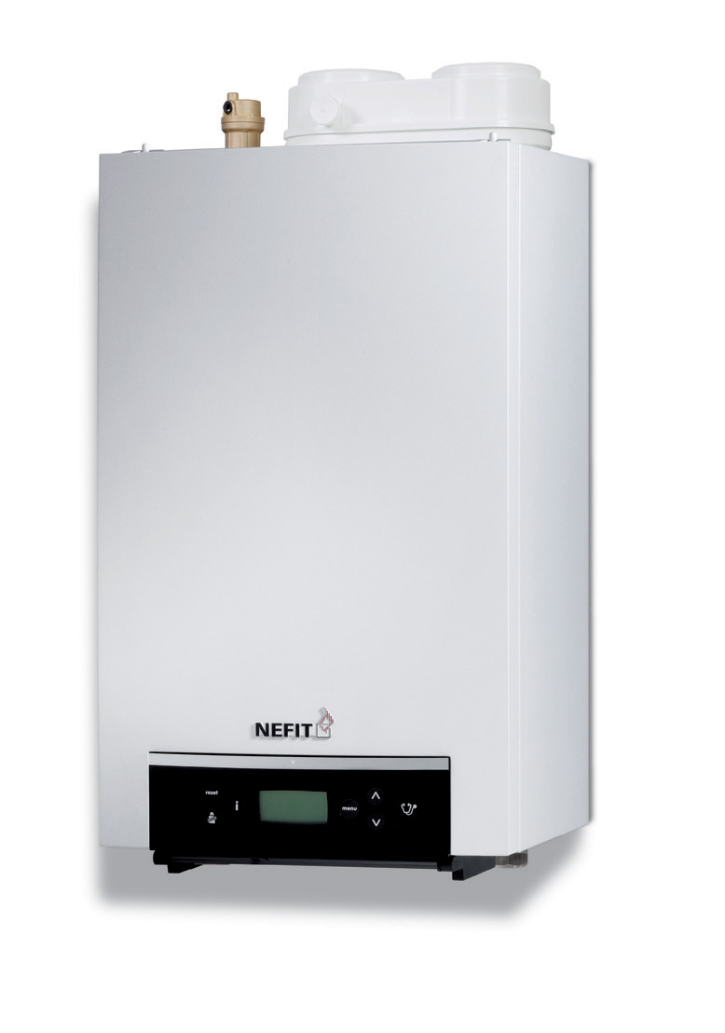
PRIJSONTWIKKELING WOONHUIS vs CV-KETEL
200
150
145
HUIS
100
CV-KETEL
50
33
0
1990
1995
2000
2005
2010
Index 1990 = 100, prijspeil 2010
Bron: Bouwhulpgroep
Notes:
Another example. This slide shows how much the average costs of a boiler has decreased and how much the average cost price of a house has increased in the past twenty years. The maximum innovation for a standard boiler has already been reached. The engineers have looked at it as a system. A system which has been optimized to the maximum over the past 20 years. Houses could have been 50% cheaper if we had looked at it as a System...we now <sheet> ..

Slide 20

Notes:
<sheet> look at it as a collection of different products which don't interact with each other. If we see a building as a comprehensive system we would perhaps choose other ways of designing, engineering and sizing the components of a building, instead of layering the products to achieve the end result. In my opinion this is the biggest technical issue in the building industry at the moment. By thinking more about systems and building with these in mind, we would be able to achieve a more sustainable building environment, which would ultimately produce a more guaranteed self-sufficient building.

Slide 21
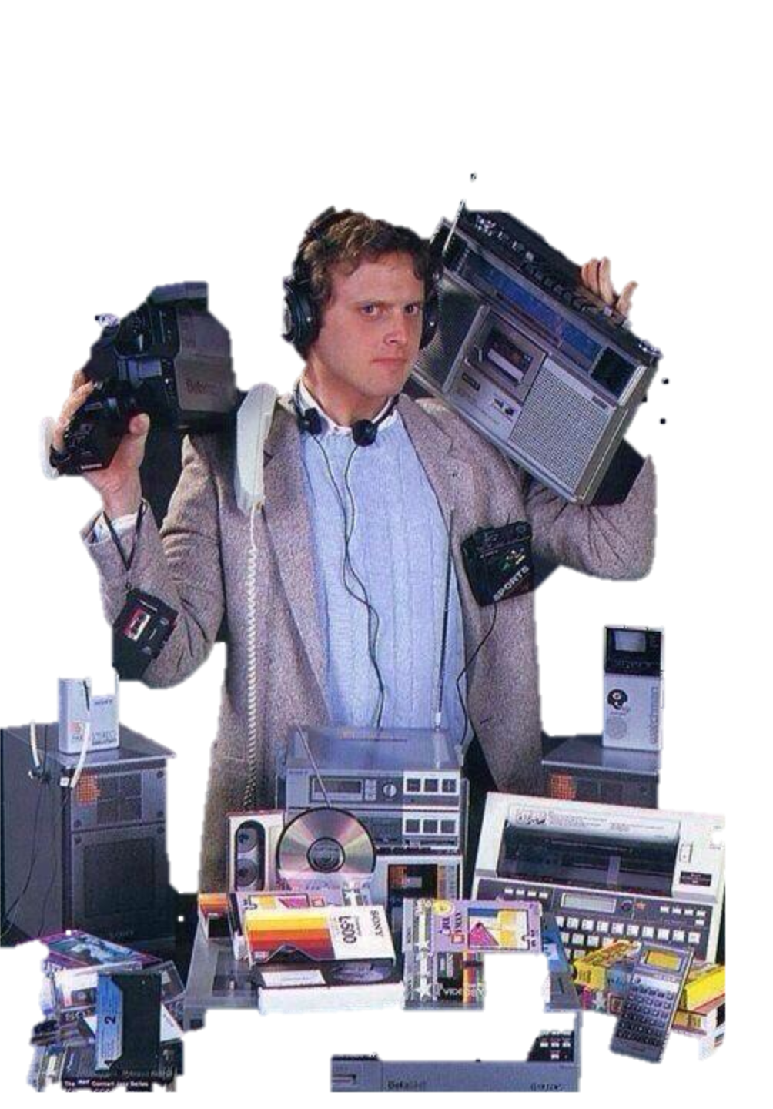

20 jaar later
Notes:
For instance think about this picture

Slide 22
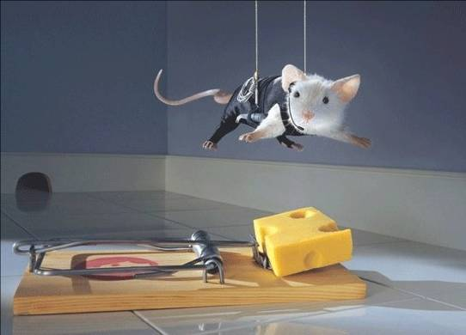
Notes:
However.... <sheet>

Slide 23
PARTIJEN IN DE BOUWINDUSTRIE
WOONINDUSTRIE
makelaar
PROCES
bank / financier
BEWONER
onderaannemer
eigenaar
installateur
ontwikkelaar
gebouwbeheer
sloper
aannemer
prefabbouwers
architect
recycling
groothandel
constructeur
advisseur
bouwproducent
OVERHEID
advisseur
bouwmanager
Grondstoflev.
BOUWINDUSTRIE
Notes:
This is the building industry as we know it today. Imagine that everyone works within his own box. Do they really understand the earning model of each other? I don't believe. So we have a lot of what we call failure costs, transaction costs and the unnecessary costs of piling products. The construction industry is like the automotive industry of the early 20th century <sheet> …

Slide 24
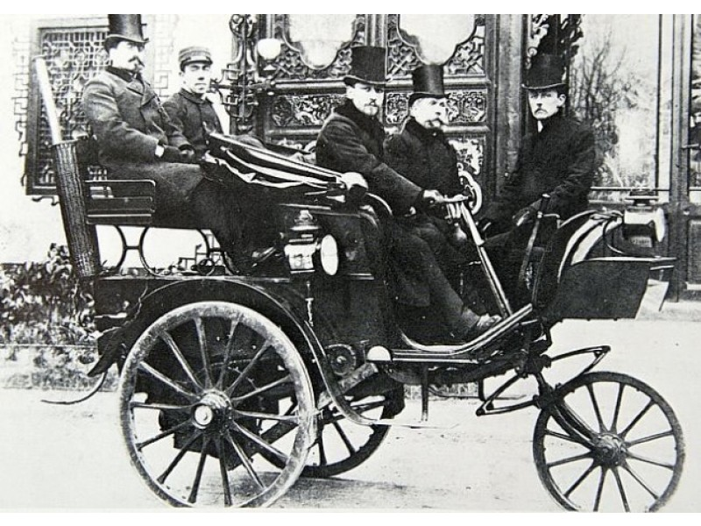
Notes:
when blacksmiths were commissioned to redesign the stagecoaches into a car. And it should be this <sheet>.

Slide 25
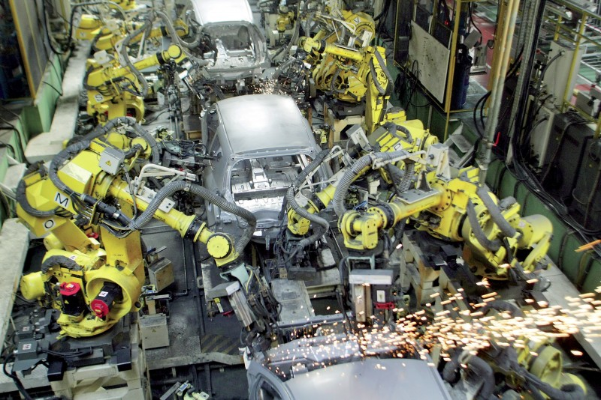
Notes:
The way to make our housing stock sustainable can be seen as more of an industrial task. It's no longer a task for local contractors. It's the biggest challenge for the whole industry including the entire sup_ply chain.

Slide 26
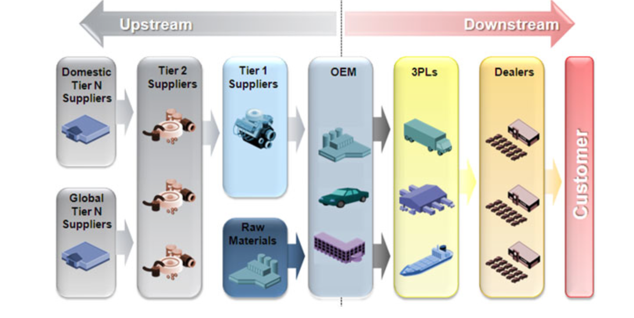

Slide 27
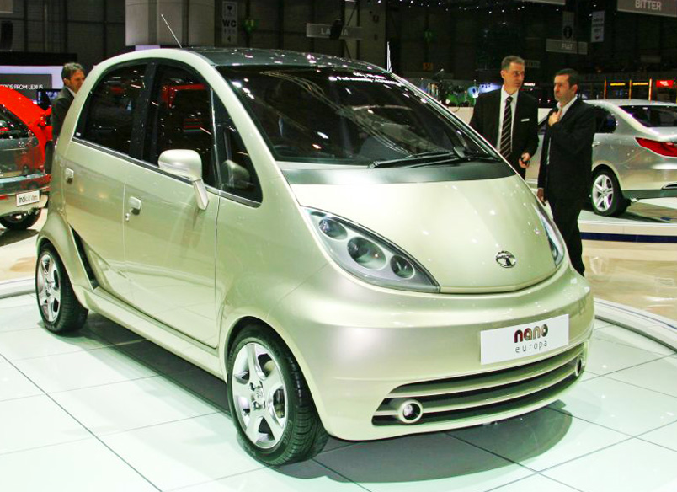
Notes:
What you see here is an example of innovation. Maybe you know this car. It is the Tata Nano, a 2000 dollar car. The project of the Tata Nano started with a seemingly unachievable ambition. What happened? Every concept that makes a car a car was reinvented by innovation teams all over the world. What looked to be unachievable has now been achieved by innovation. <sheet>

Slide 28



Slide 29
ECONOMISCHE KLANTWAARDE
TOTAL COST OF OWNERSHIP
ENERGIE
ECONOMISCHE KLANTWAARDE
EXPLOITATIE
EXPLOITATIE
INVESTERING
INVESTERING
TRADITIONEEL
KANS
Notes:
What can we achieve? Lower investment, lower operating costs and NO energy bills anymore. <sheet>

Slide 30
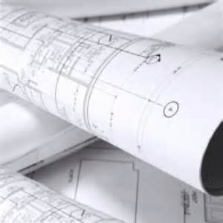

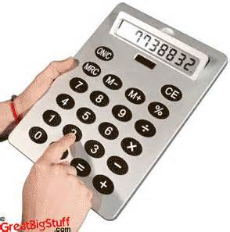
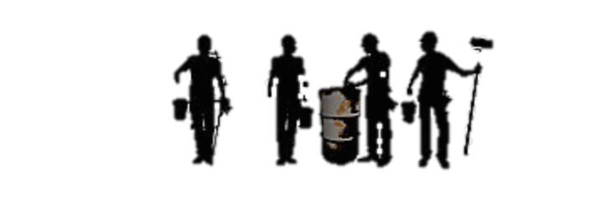

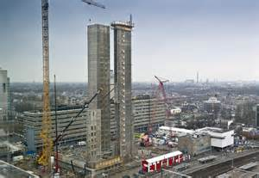
verantwoordelijkheid ??
OPDRACHTGEVER
AANNEMER
Notes:
Normally the principal is hiring the designer and engineers. They are the ones who create the specification of the building. <click>
The building company delivers a proces, to create the invention of the principal. What happened than? Sustainable houses are to expensive and a have a lack of performance. We want new responsibilities

Slide 31
behoefte
AFNEMER
AANBIEDER
oplossing
Gegarandeerde prestatie
Lage prijs / hoge kwaliteit
TCO benadering
Notes:
We want a building industry which deliver his own products...not processes. I'm not selling a process when I buy a car for better mobility, for instance. The role of the designer is moving to the building company. The principal should look at the market and choose a solution, with the right guarantees and fit with his need.

Slide 32
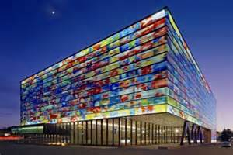
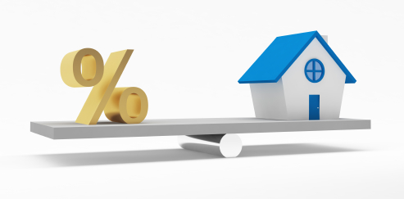
condities
Afnemer
aanbieder
businesscase
Notes:
The program Energiesprong is build around this vision. The conditions which we have created the past four years, are about the context of the building industry. New parts of law, new forms of financial products, deal with incorrect stories etcetera. <click> And of course we have to do it with a positive businesscase for principal, renter and building company.

Slide 33

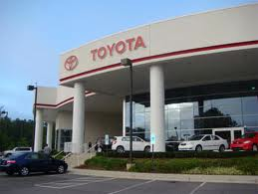



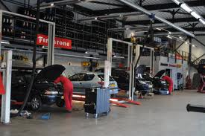


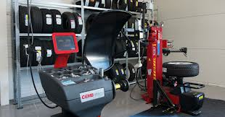
FABRIEK
LEASEMAATSCHAPPIJ
GARAGE
Verkoop
Reparatie
Onderhoud
Product
Marketing
Mobiliteitsdiensten
KLANT

Slide 34












Bouw / Installatie / Onderhoud
FABRIEK
LEASEMAATSCHAPPIJ
GARAGE
Verkoop
Reparatie
Onderhoud
Product
Marketing
Woondiensten
KLANT

Slide 35
FABRIEK
LEASEMAATSCHAPPIJ
LEASEMAATSCHAPPIJ
GARAGE
Product
Marketing
Verkoop
Woningen
Reparatie
Onderhoud
KLANT

Slide 36



DRIE UITGANGSPUNTEN
BUSINESS CASE IS SLUITEND
GEGARANDEERD NUL OP DE METER
TEVREDEN BEWONERS

Slide 37
BETERE KWALITEIT
CONDITIES
LAGERE PRIJZEN
SCHAAL
GARANTIES
Notes:
But this was not upscaleble. The biggest challenge was to reduce the costs with more than 40% for a closed businesscase.
Therefore I created a deal with a few social housing associations and the 4 biggest building company's in the Netherlands. The deal is to convert about 111,000 houses to become completely energy self-sufficient before 2020. The promise of the buildingcompany's? 1) 40 to 50% decrease in price, through innovation, industrialization and the benefits of scale, 2) a good and guaranteed offer for the residents and 3) through the price drop a closed businesscase for the social housing company's <sheet>

Slide 38
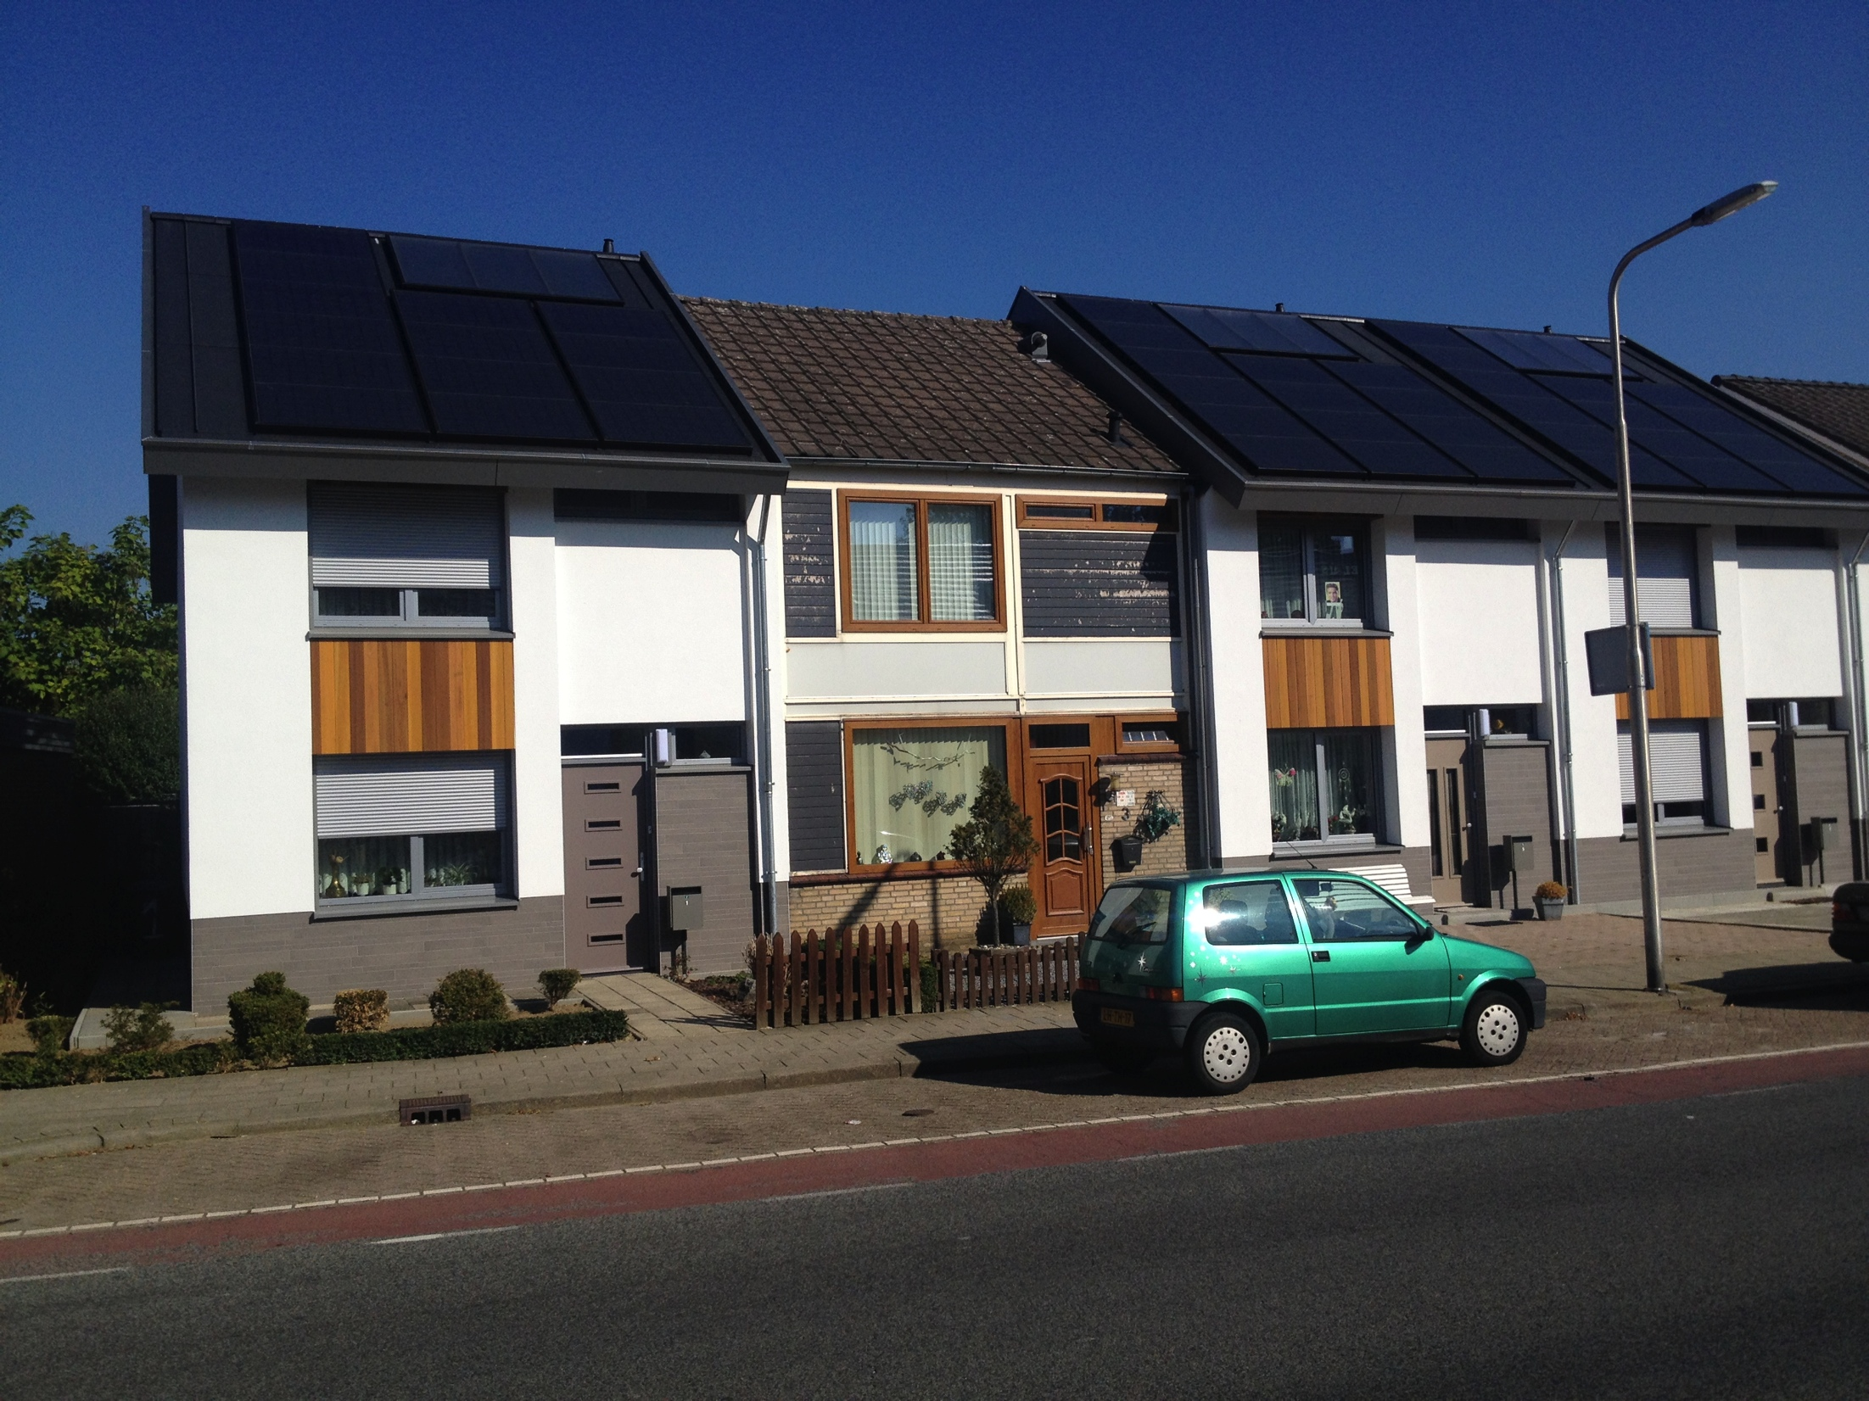
Notes:
For example one of our experiments. An 8 day renovation resulting in a house with an energy-zero-use. I can tell you one hour about the proces but I should go to the end to let you see the result <fast clicking>. What you see here is a house with a better performance than that of a new building. <sheet>

Slide 39
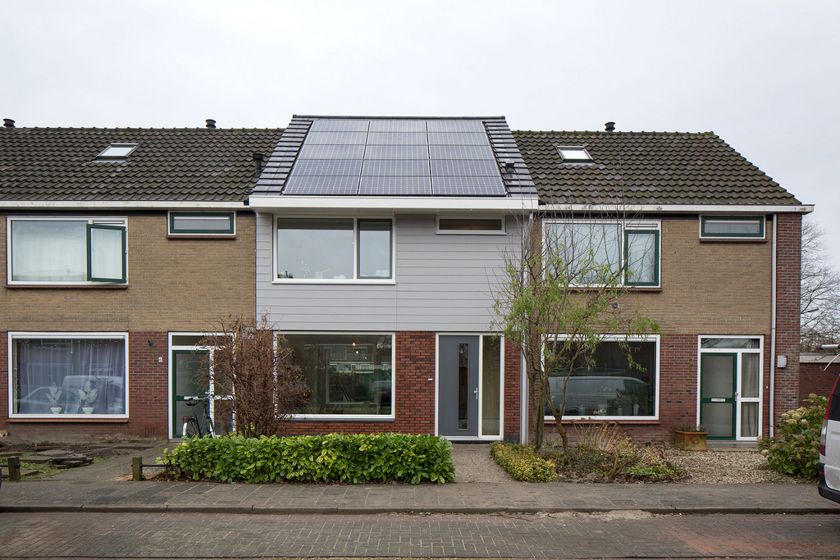
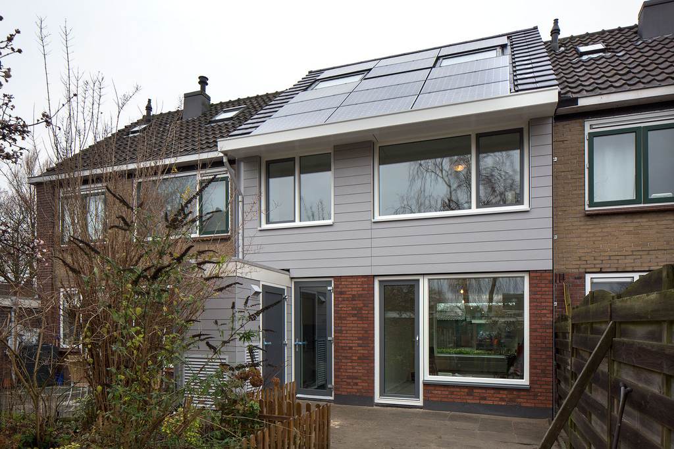
Notes:
We are now working on different prototypes whit new innovations.
Like this one with the total technical unit outside the house to carry out big interventions inside the house during the renovation. Even handy for service activities, the resident doesn't have to be at home for services. All lines, cables and pipes are hidden in the walls witch were completely fabricated in the factory.

Slide 40
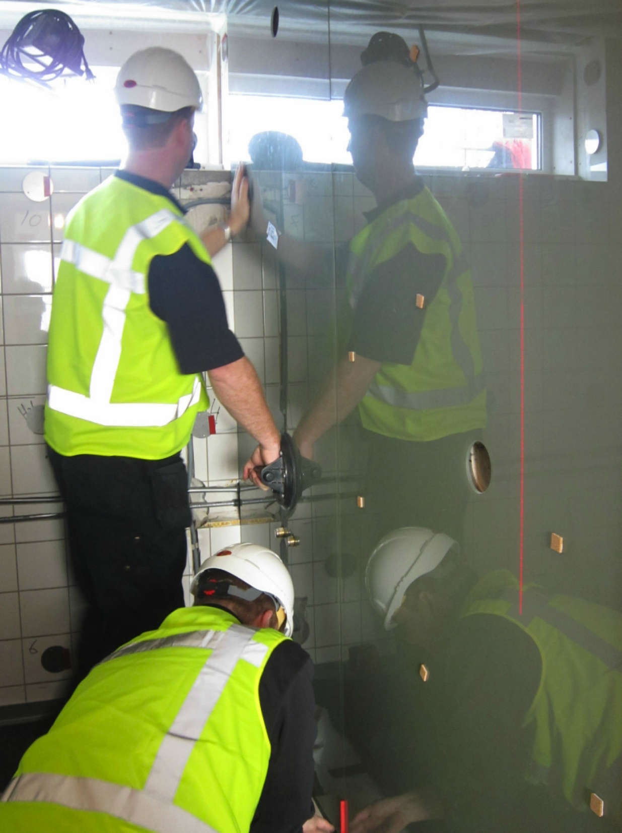
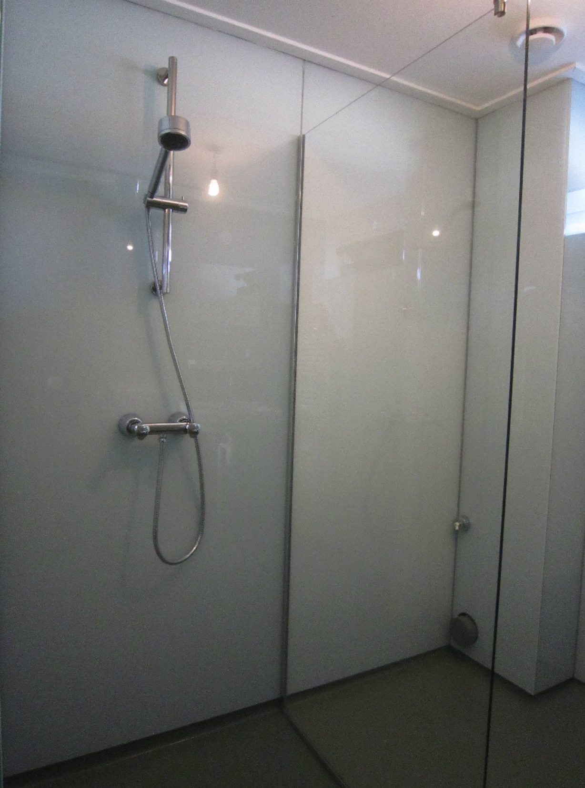
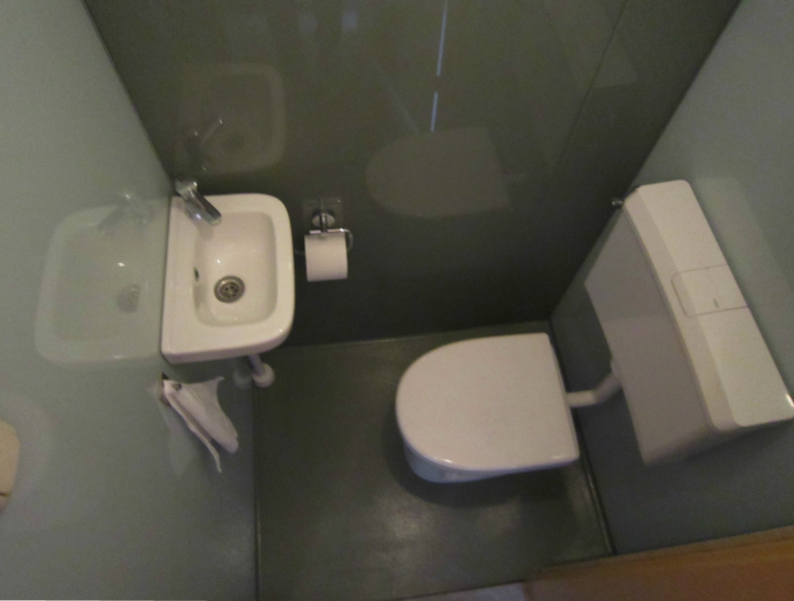
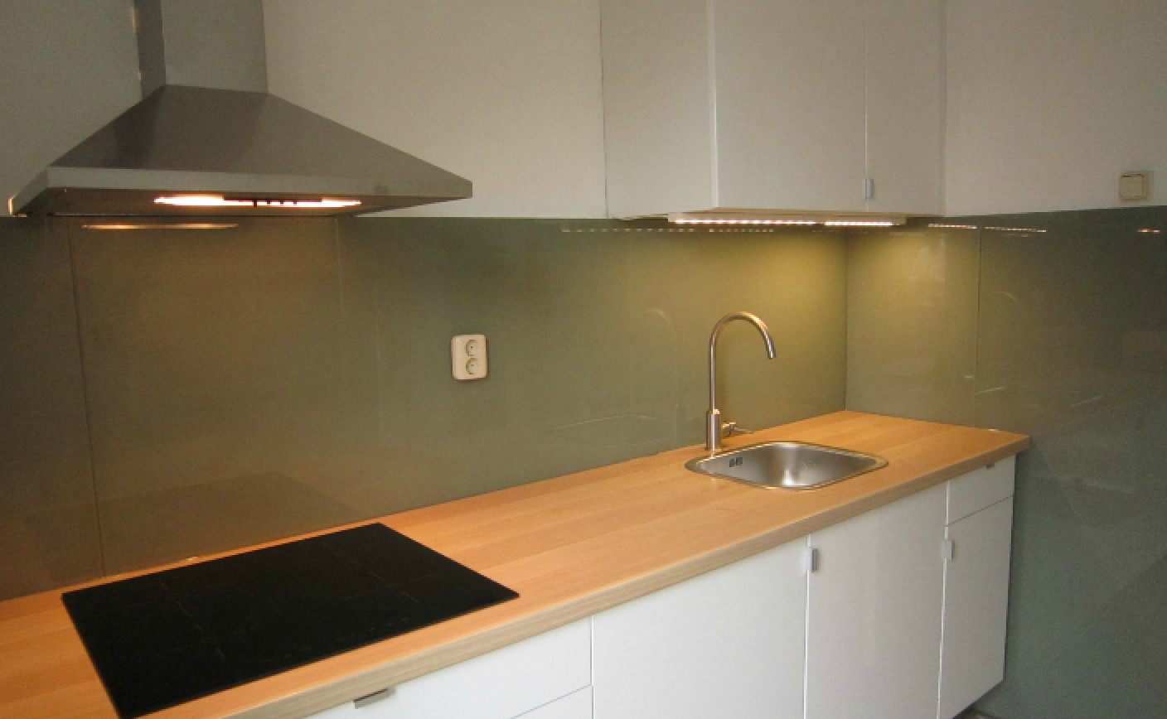
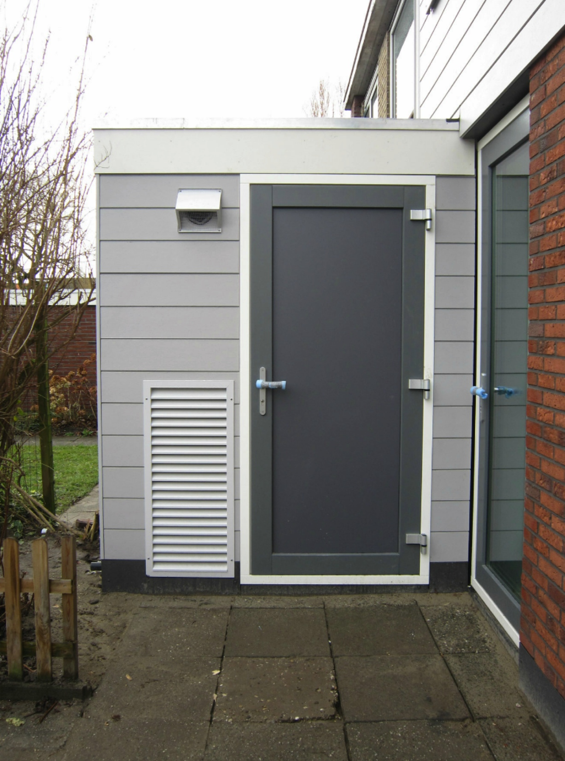
Notes:
Or look at these internal components. The complete toilet, bathroom and kitchen can be renovated in one day with equipment applied in a factory. <sheet>

Slide 41
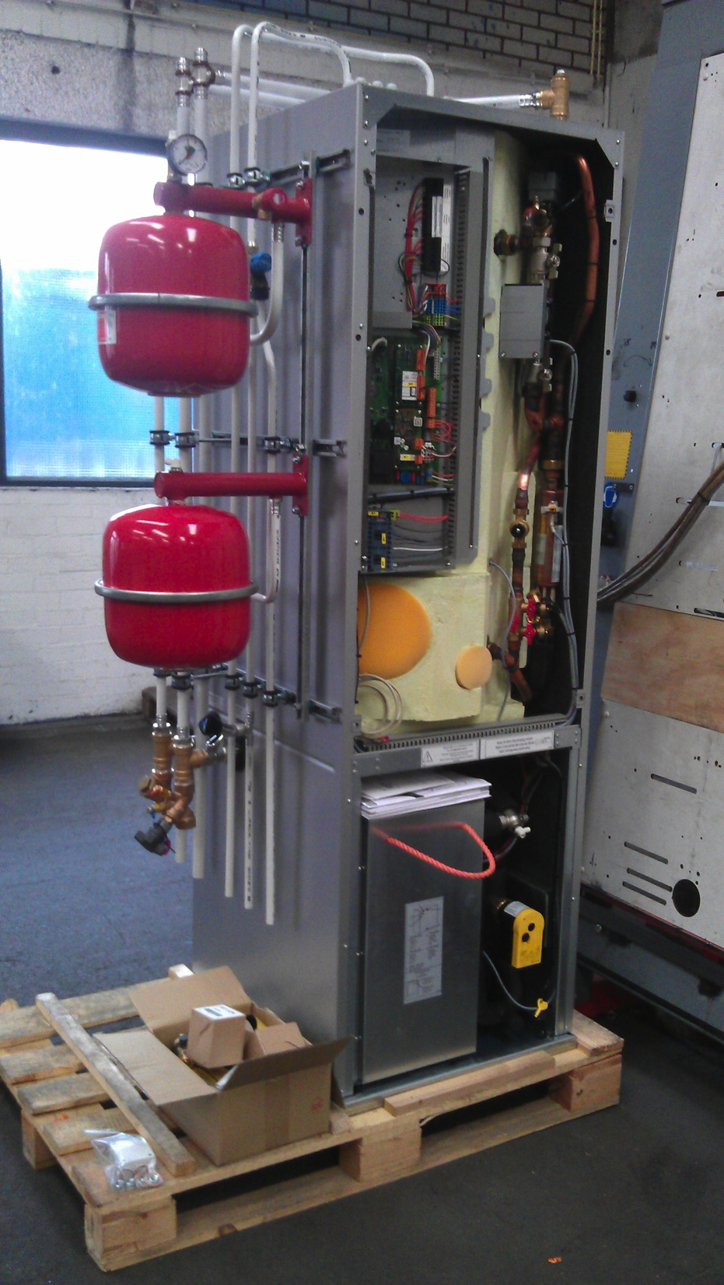
Notes:
This is prototype two of the installation unit, a compact factory made unit with equipment from many suppliers. Within a few years it will be totally lost in the skin and roof of the house

Slide 42
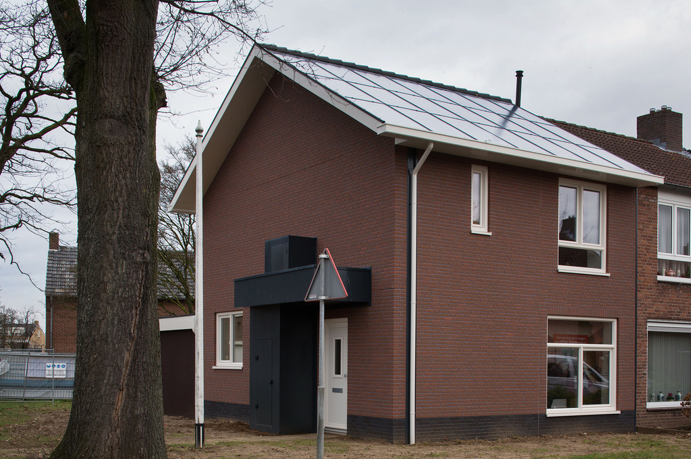
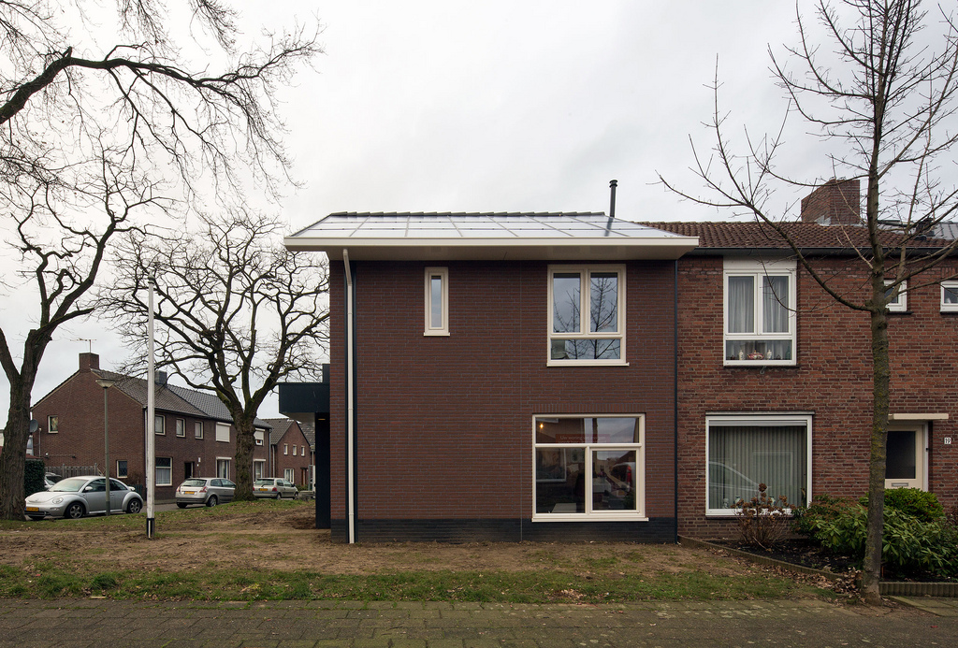
Notes:
ere you see another example with a similar solution...integrated solar panels and a skin of artificial stone.

Slide 43
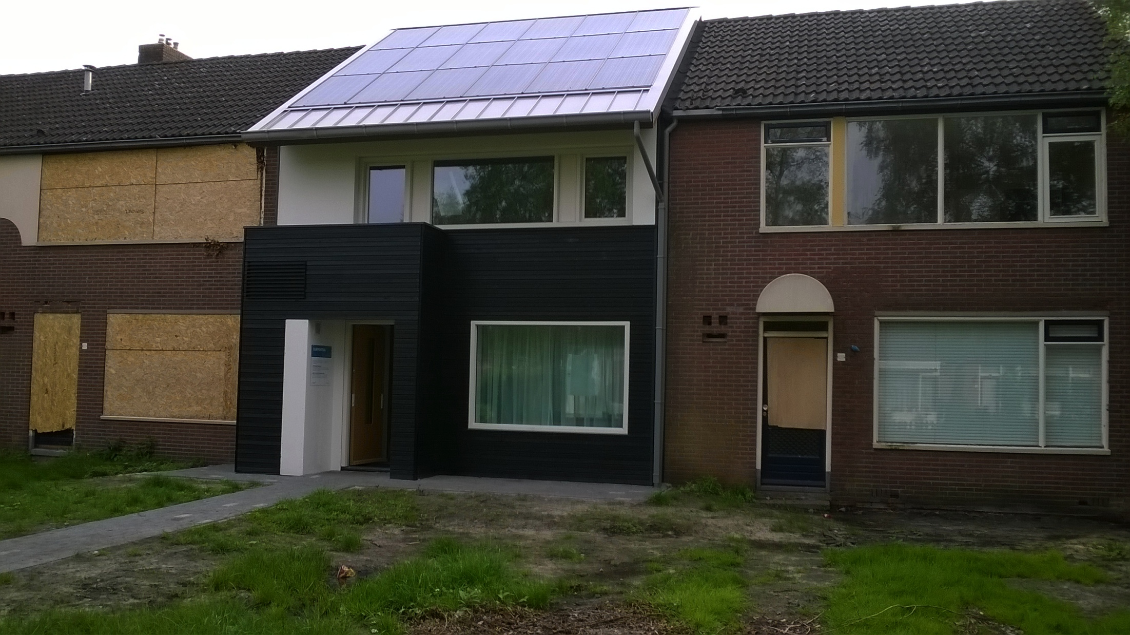
Notes:
This is the second prototype of this company.

Slide 44
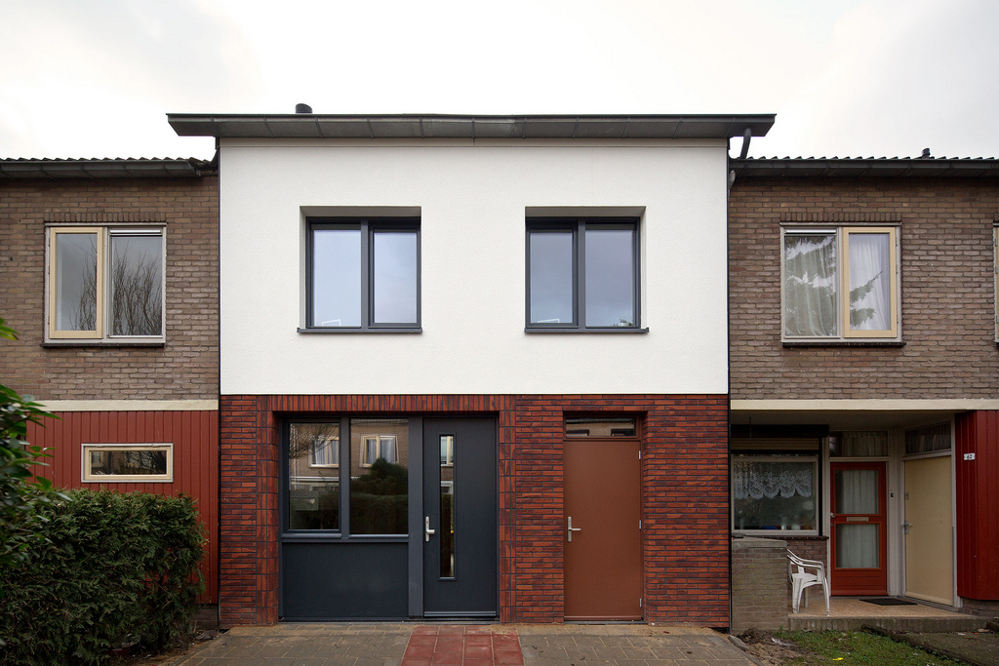

Notes:
And here another one

Slide 45



Roossendaal 2010
130.000
Kerkrade 2011
100.000
Apeldoorn 2012
80.000
Kostprijs in euro’s
Deal 2013
Na 11.000!!!
60.000
40.000
TIJD
PRESTATIE
PRICES INCL. BTW KEUKEN/ BADKAMER
Notes:
What I have shown to you is that we can make better, integrated solutions for lower prices.

Slide 46








Notes:
*0% van de voorraad bestaat uit 18 dominante woningtypes…en zijn dus waardevolle casco’s waar zonder opdrachtgever een oplossing voor bedacht kan worden. Het zijnde platformen van de toekomst.

Slide 47


Slide 48

De Energieneutrale businesscase
Verbruiksscenario’s
NCW Huidige energierekening
electra | gas | investeringsruimte
1500 | 1000 | € 30.145,00
2000 | 1500 | € 42.235,00
2500 | 1700 | € 49.130,00
3000 | 2200 | € 61.218,00
3500 | 1700 | € 55.995,00
4000 | 2500 | € 73.227,00
Notes:
Verschillende energiegrbuiken en de bijbehorende investeringsbedragen voor woningcorproaties .. dit is op basis van de businesscase die ook van toepassing is binnen de Stroomversnelling. Gebaseerd op langere levensduur.

Slide 49
FUNDERING VAN STROOMVERSNELLING
1.Business case
Wat is het maximale investeringsplafond voor geschikte woningen om 5,25% rendement voor corporaties te garanderen?
2. Prestatiegarantiecontract
Bouwbedrijf en corporatie spreken de prestaties en het meten van de prestaies af.
3. Woonbundel
Welke energiedienst krijgt de huurder voor de servicekosten?

Slide 50


Slide 51


Slide 52


ENERGIENOTANUL
gerealiseerd!

Slide 53

PARTICULIEREN

Slide 54
2,4
0,6
4,2

Slide 55

Notes:
Imagine that you come back after a 3 day vacation and your house is like this: renewed, more comfortable, more healthy and with the energy costs in the form of a fixed and stable amount like a mortgage.

Slide 56

Notes:
Geen innovators
Maar verbinders van verschillende beschikbare technologien - verbindingen die er voorheen niet waren
slimme combinaties maken van bestaande ideeen

Slide 57

The King of the building industry
IS PART OF THE SOLUTION
Notes:
A big challenge for the building industry, they are a major part of the solution to an energy-selfsufficuient building environment. We can do it with al little bit courage and a lot of vision.

Slide 58

THNX!
@greenspirator
www.greenspirator.com
www.energiesprong.nl
Notes:
Thank you.

